Slide 1
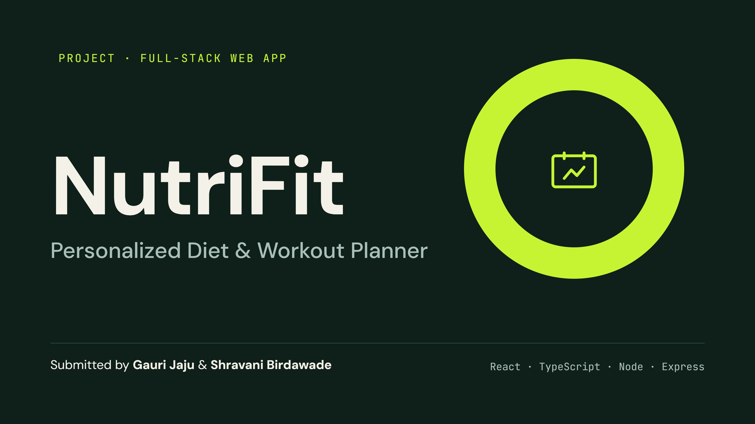
Notes:
Introduce the project: NutriFit is a full-stack web app that generates diet and workout plans and tracks daily progress. Presented by Gauri Jaju and Shravani Birdawade.

Slide 2
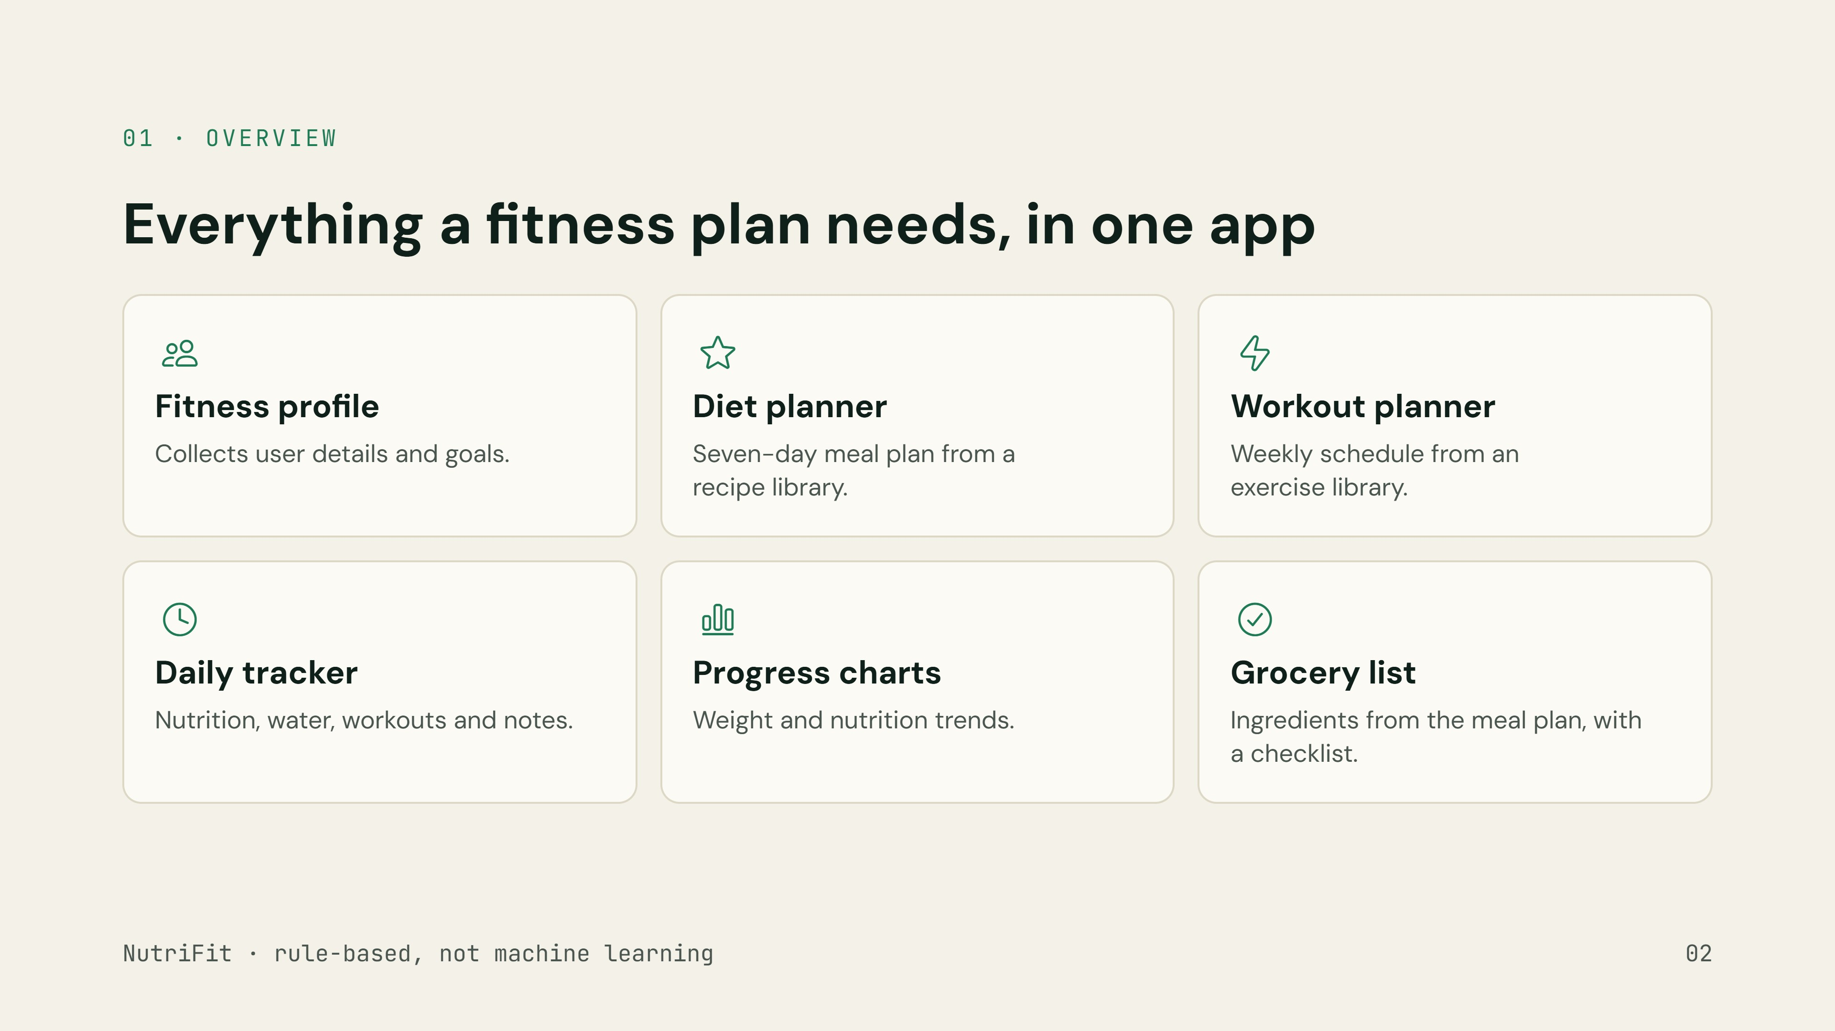
Notes:
NutriFit combines six features. The planner is rule-based: it uses predefined conditions and data, not a trained machine-learning model.

Slide 3
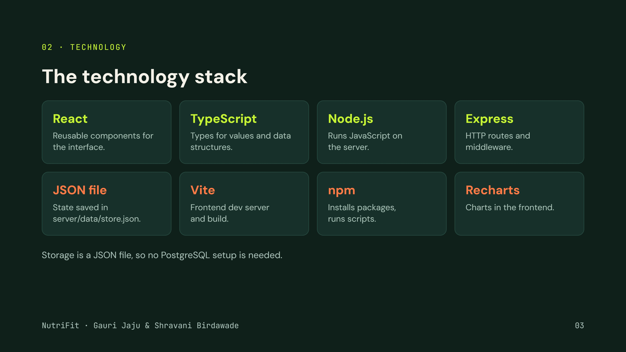
Notes:
Lime items are the core web stack; orange items are supporting tools. The current implementation persists to a JSON file, not PostgreSQL.

Slide 4
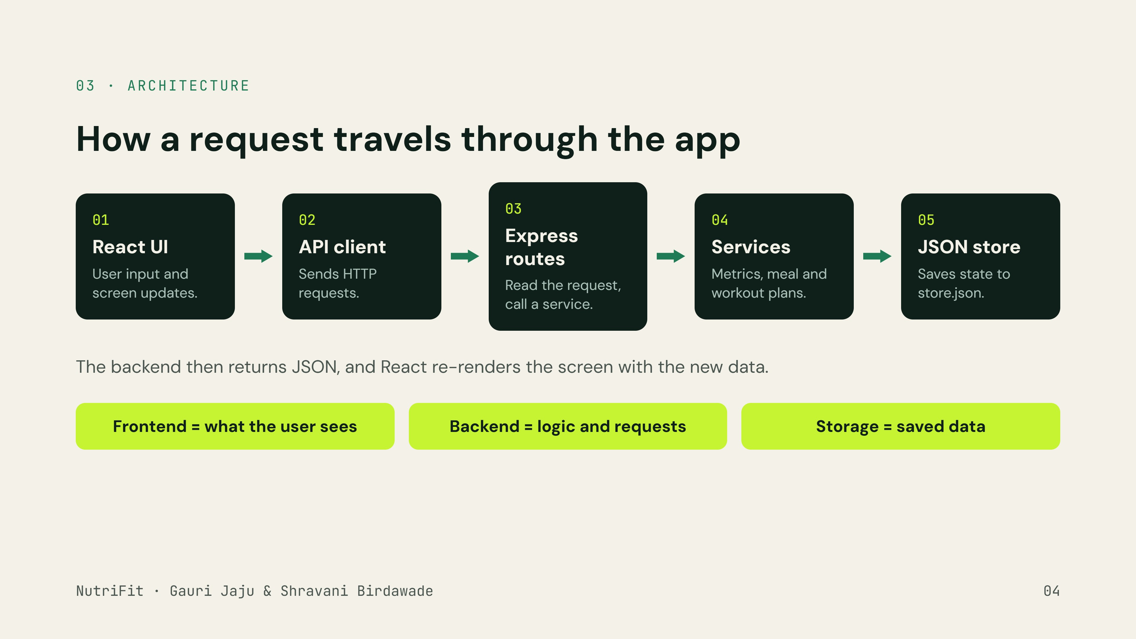
Notes:
Walk through the flow: the user enters information in React; the API client sends a request; Express routes it to a service that calculates or generates; the database module reads or writes the JSON file; the response goes back and React updates.

Slide 5
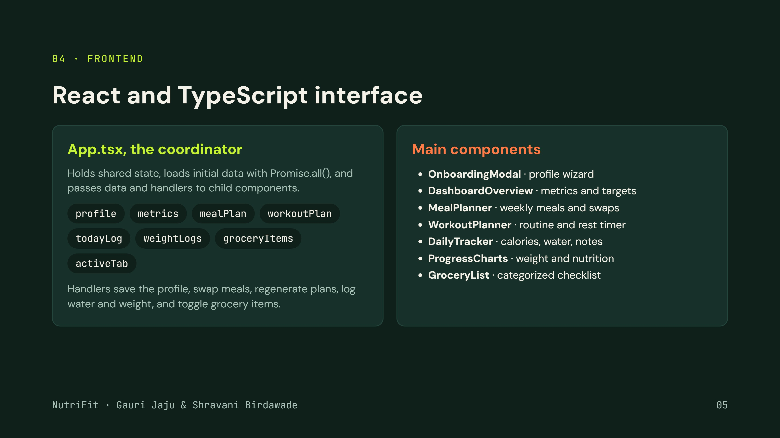
Notes:
useState stores changing values, useEffect runs side effects such as loading data, and event handlers respond to clicks. Other components include RecipeModal and Navbar.

Slide 6
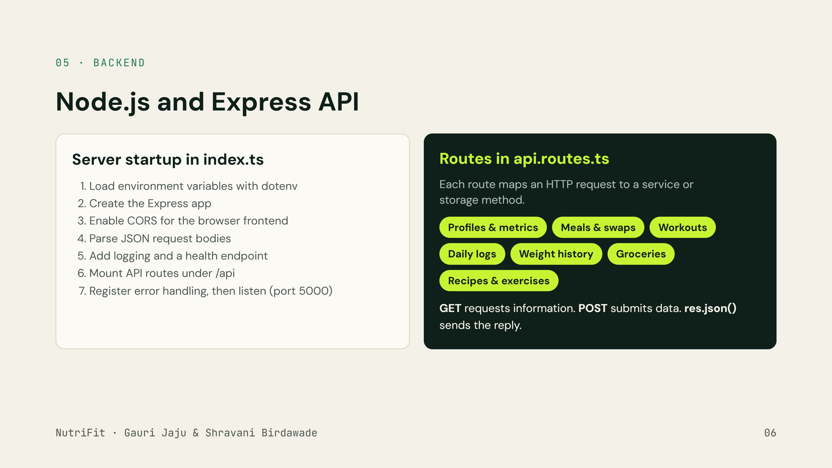
Notes:
CORS (Cross-Origin Resource Sharing) matters because Vite and Express run on different ports. Middleware is a function that runs during request processing, such as JSON parsing.

Slide 7
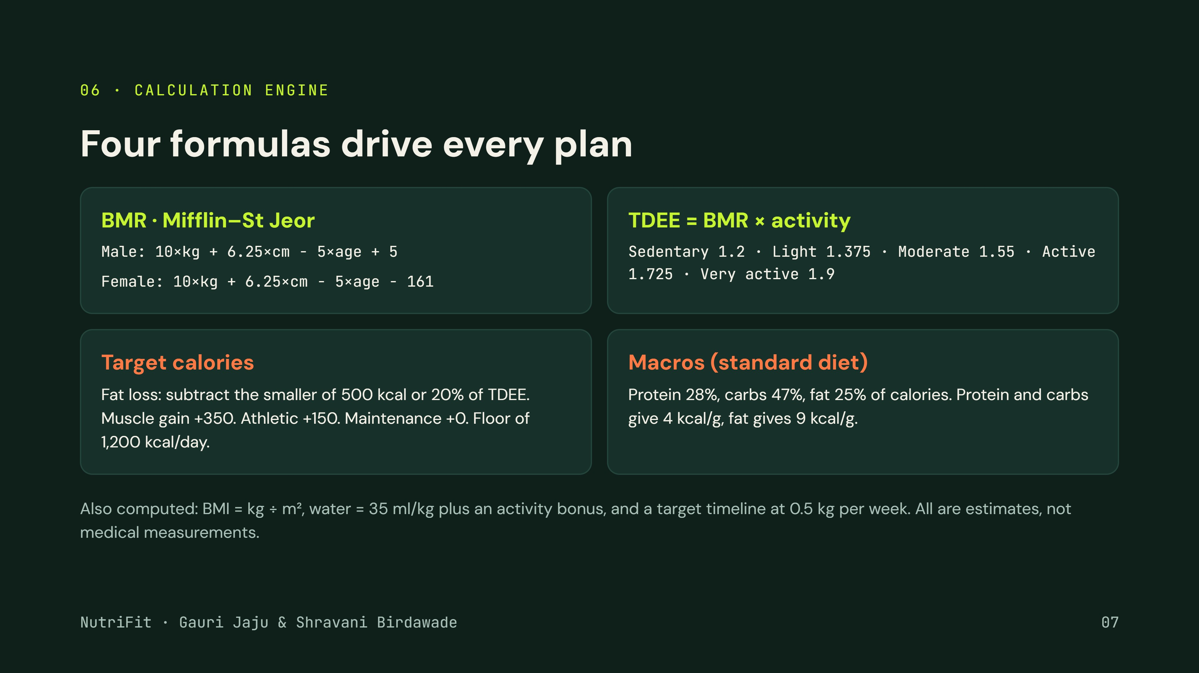
Notes:
BMR is energy used at rest. TDEE scales BMR by activity. The 1,200 kcal minimum is a software rule, not a universal dietary recommendation.

Slide 8
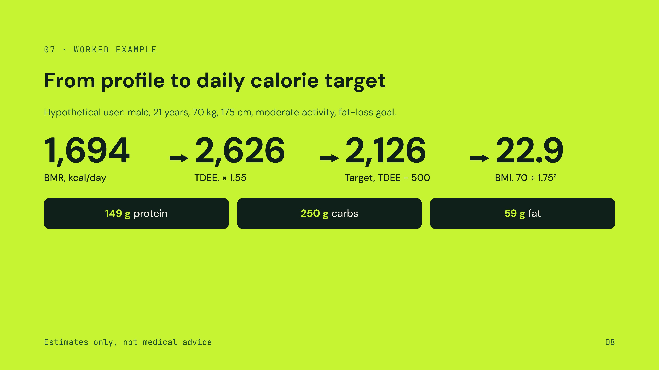
Notes:
Walk the numbers: BMR 10×70 + 6.25×175 − 5×21 + 5 ≈ 1,694. Times 1.55 ≈ 2,626. Fat loss subtracts 500, giving about 2,126 kcal. Macros at 28/47/25 give about 149 g, 250 g and 59 g.

Slide 9
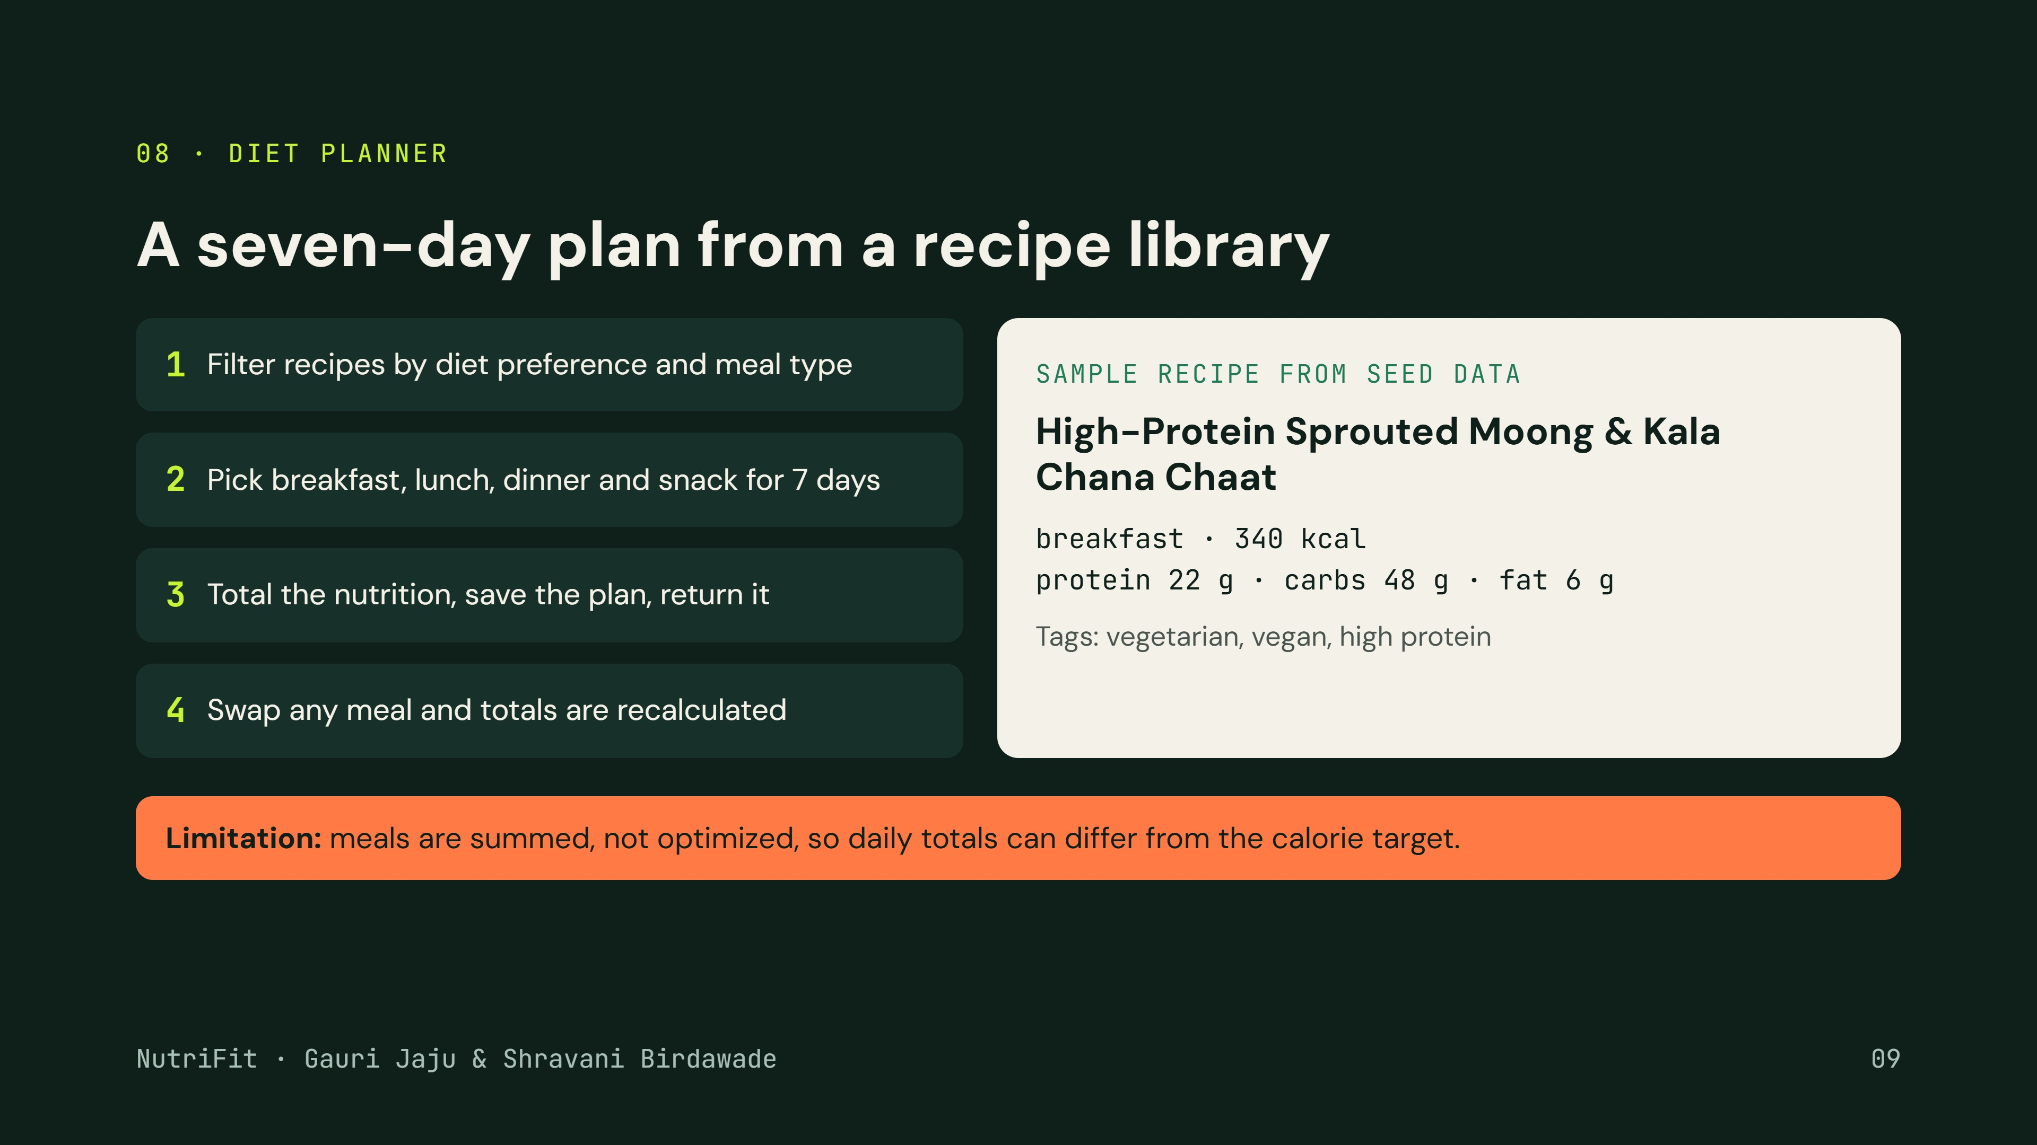
Notes:
Each recipe has an ID, title, meal type, calories, macros, ingredients, dietary tags and instructions. The grocery service groups ingredients by category but does not yet merge duplicate quantities.

Slide 10
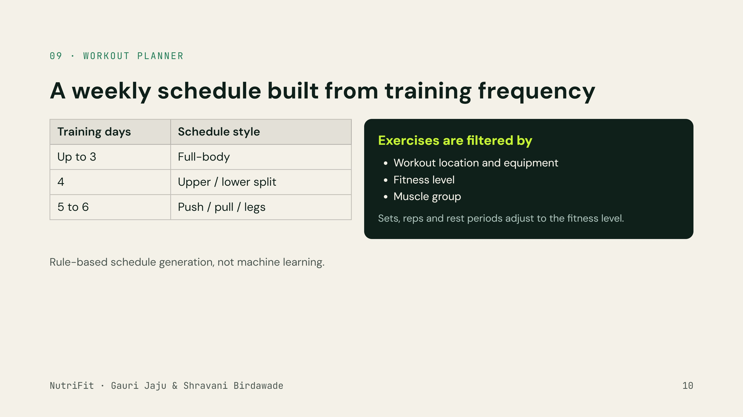
Notes:
The workout service uses a predefined exercise library. The frontend WorkoutPlanner also shows exercise details and a rest timer.

Slide 11
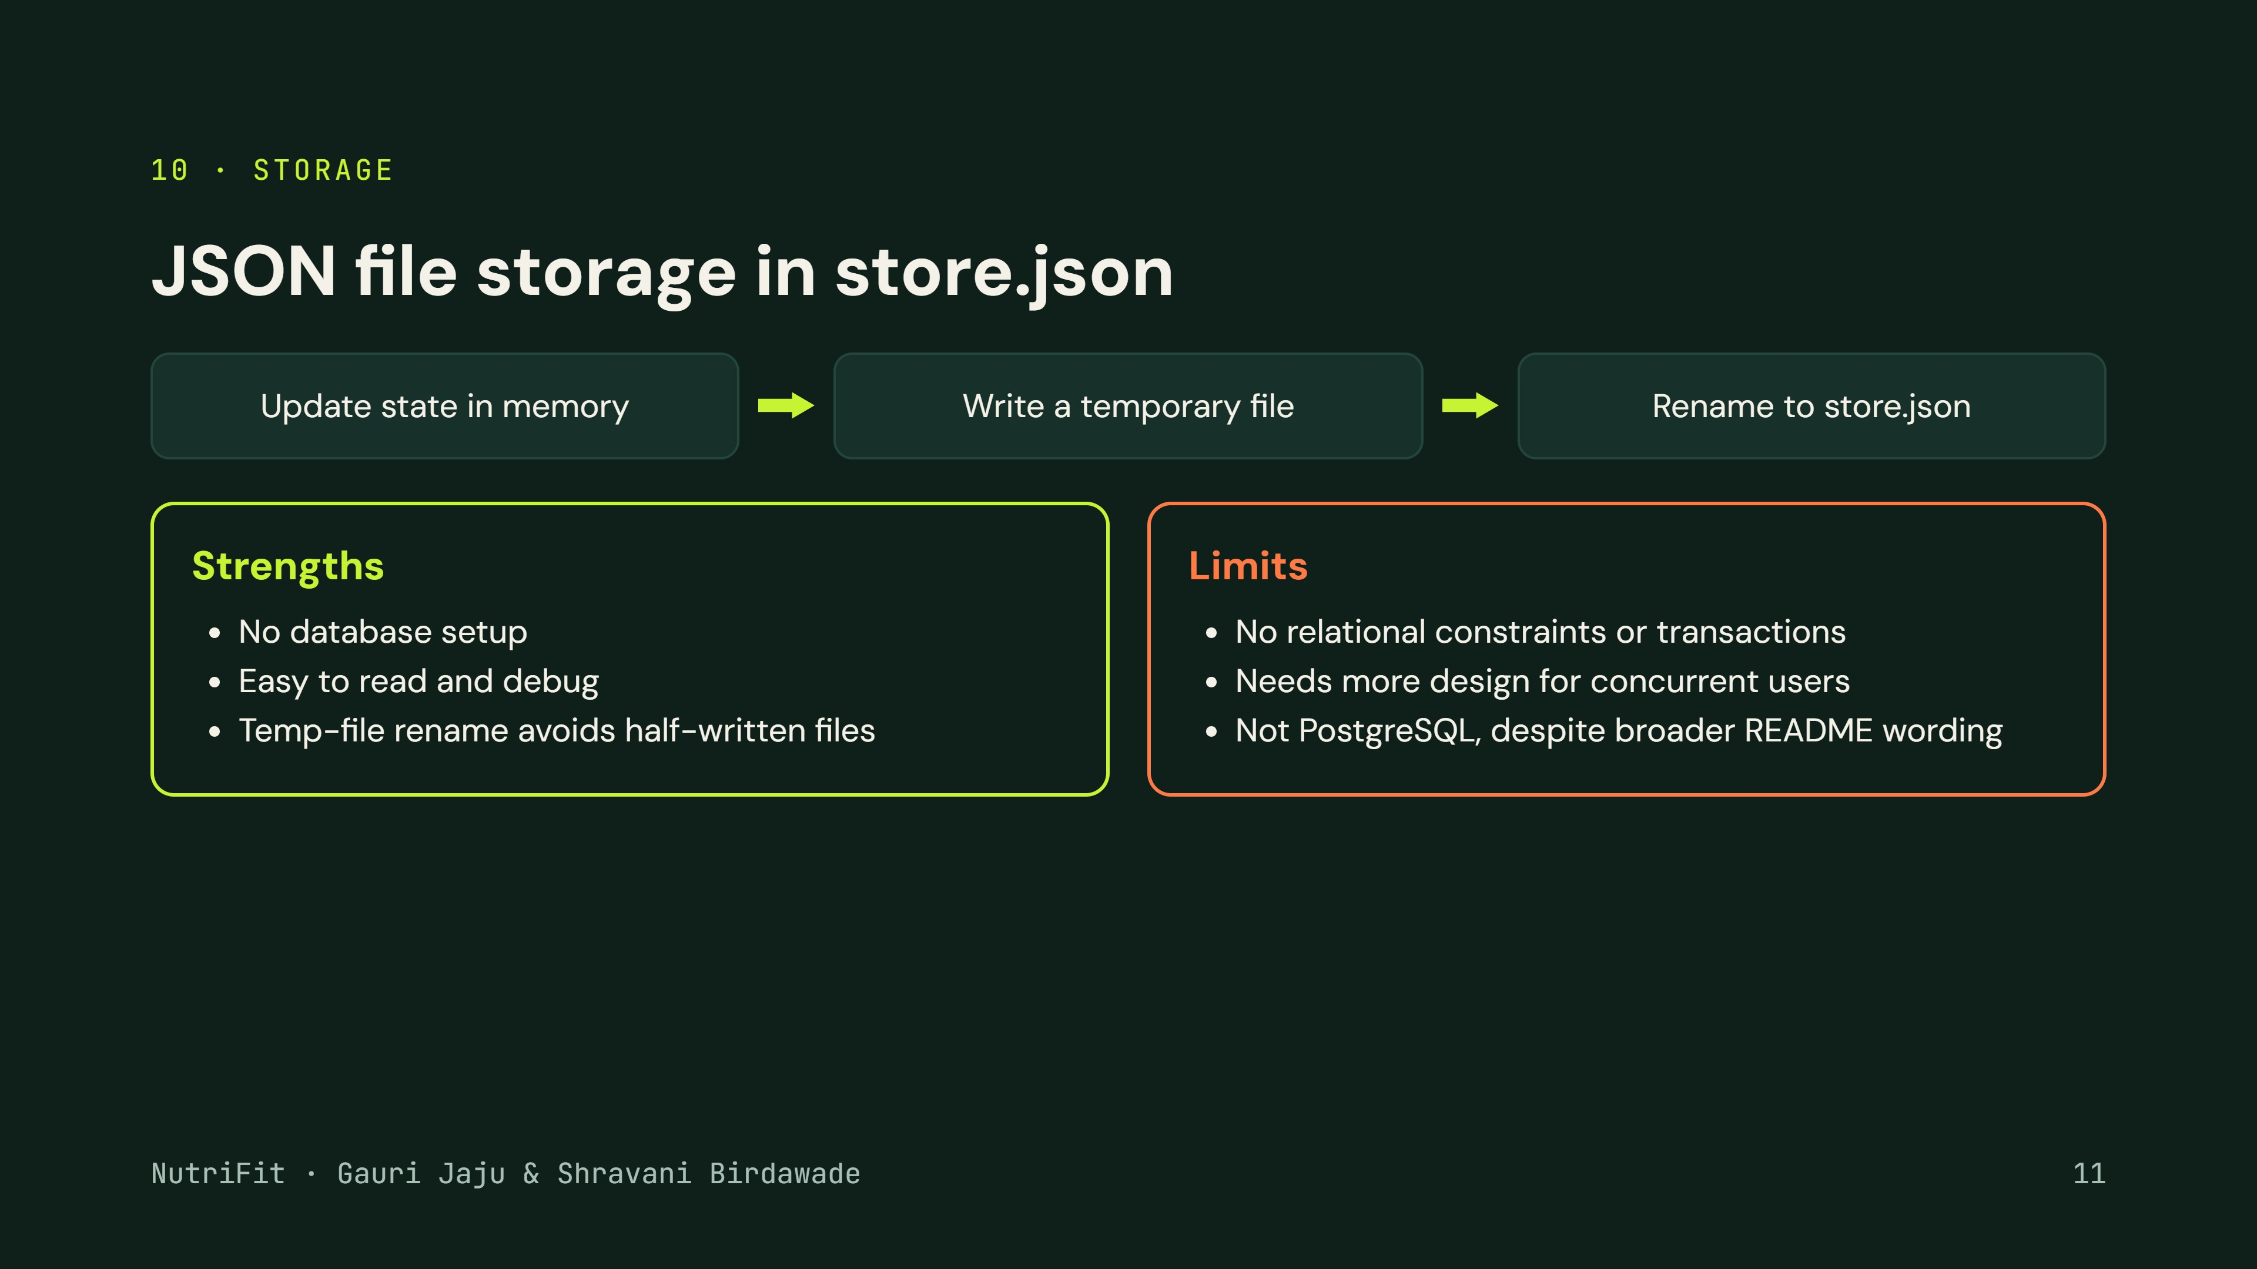
Notes:
The database module uses Node.js filesystem operations and creates default state if no usable store exists. It exposes methods for profiles, meal plans, workout plans, daily logs, weight logs and grocery items.

Slide 12
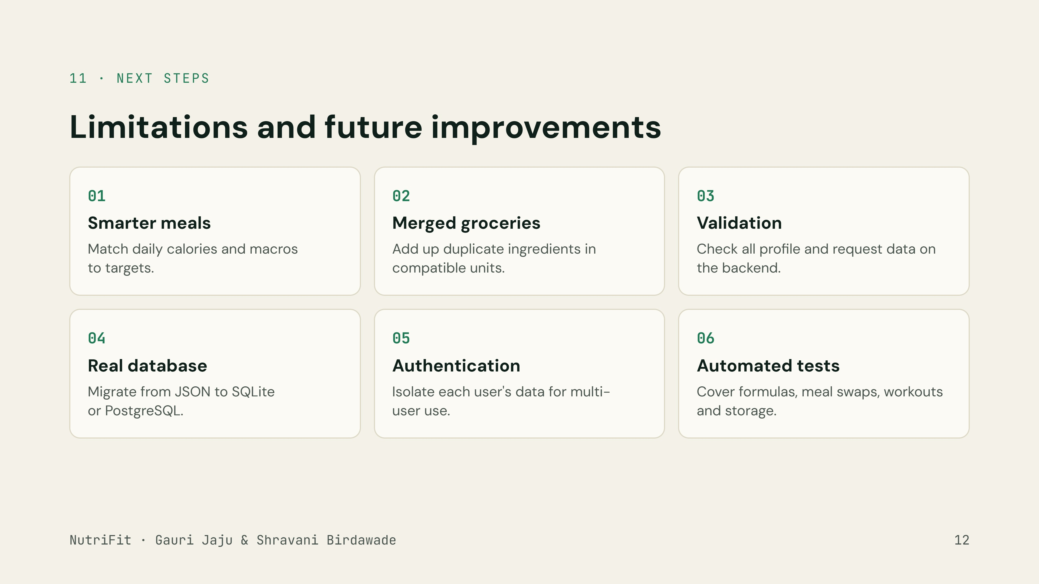
Notes:
Also worth doing: review the health-related advice and clearly communicate the limits of the estimates.

Slide 13
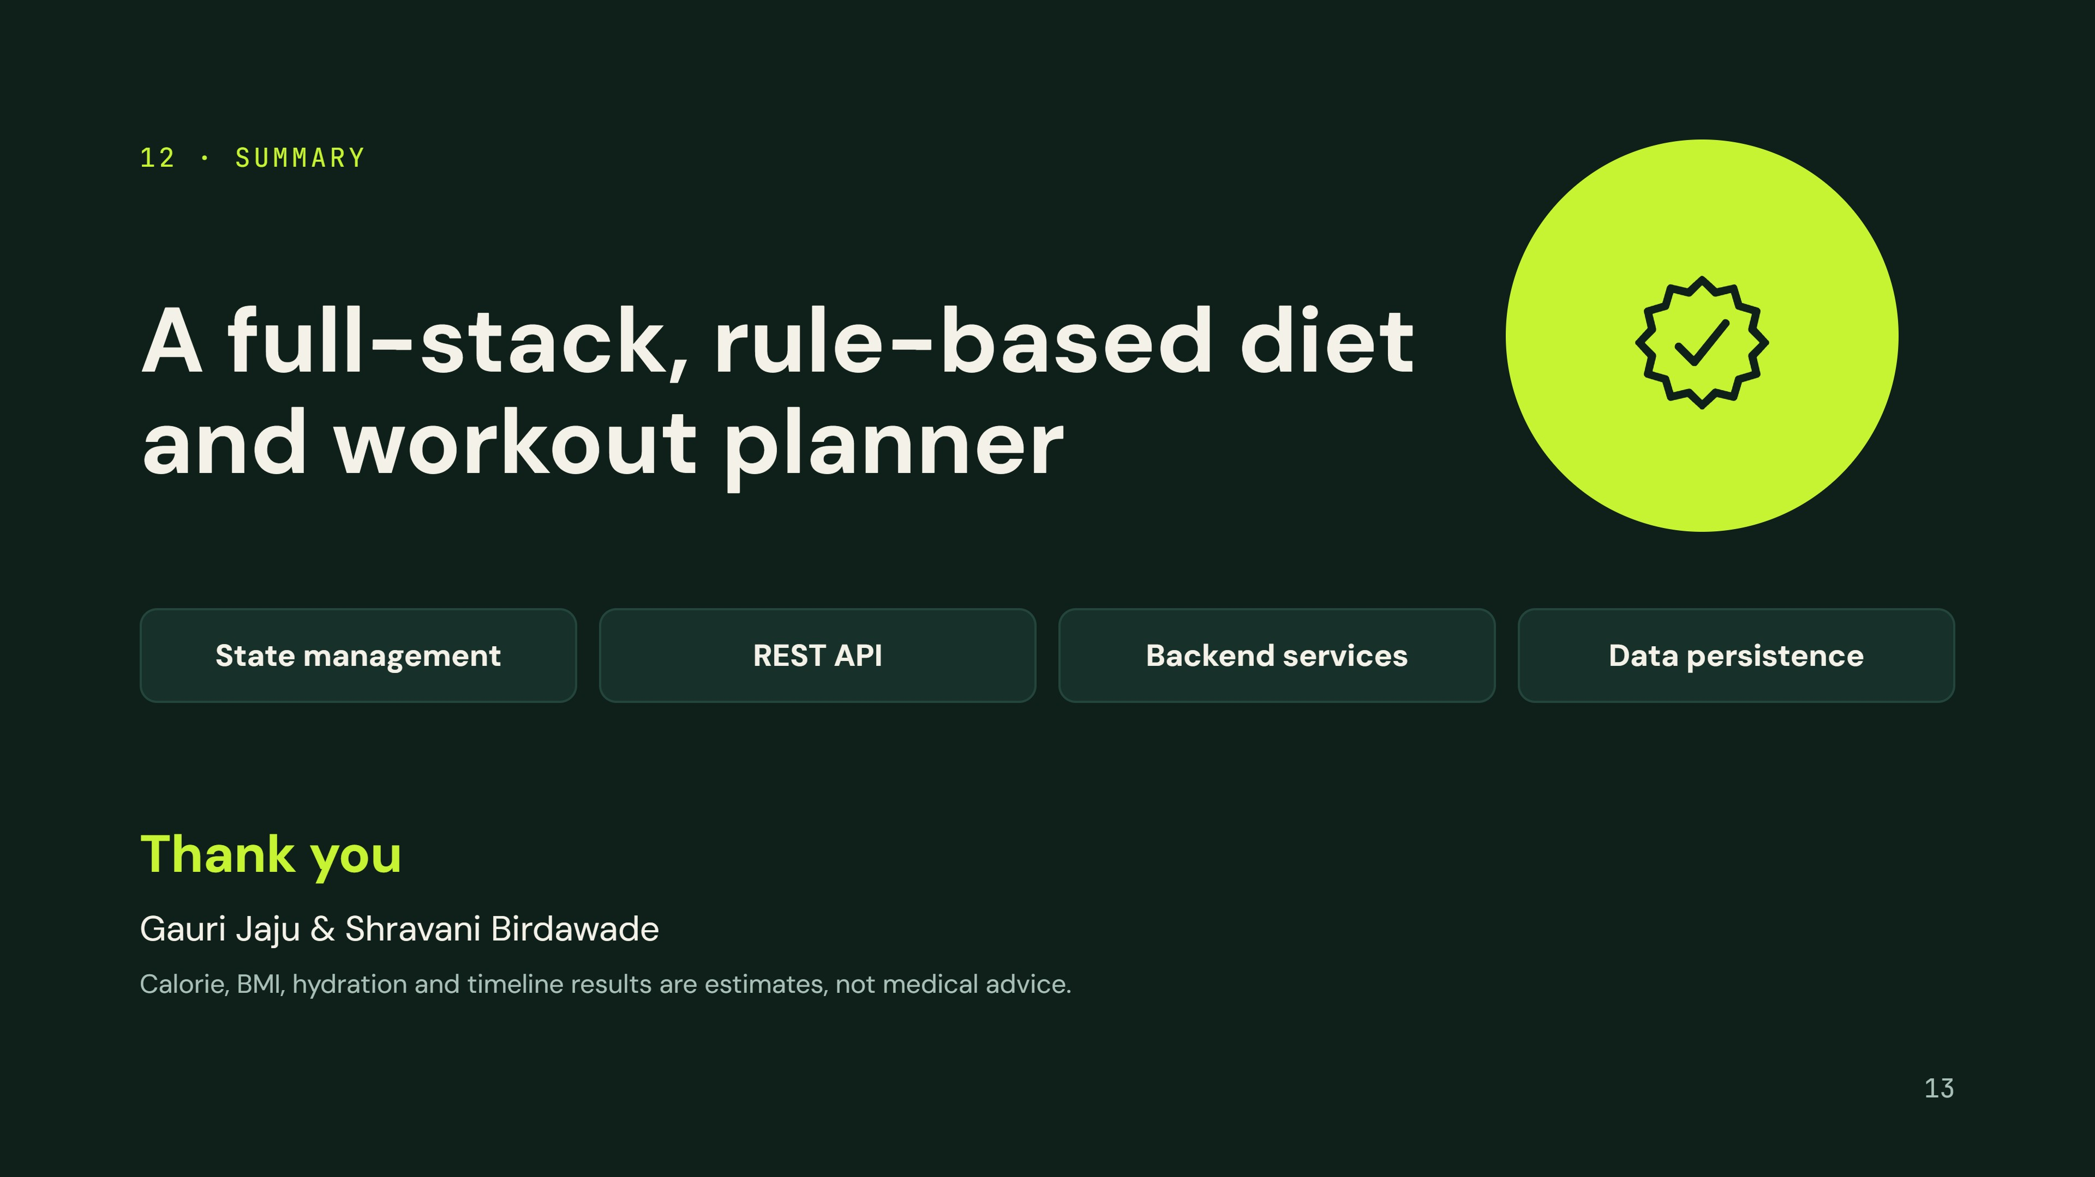
Notes:
Wrap up: React and TypeScript build the interface, the API client talks to Express, services calculate metrics and generate plans, and a JSON file persists state. Invite questions.

